Slide 1
Child abuse-II
Dr. I. Kitulwatte

Slide 2
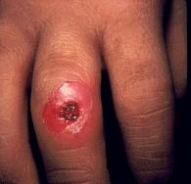
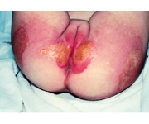
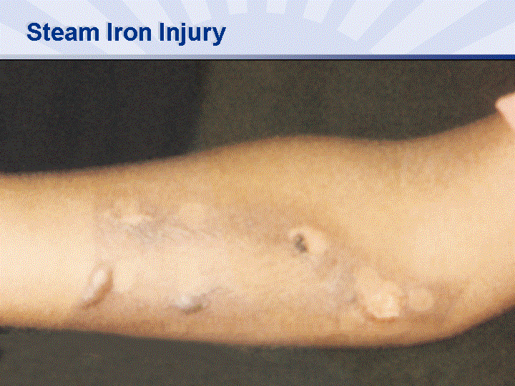
Burns
Can be moist scolds, dry burns, or electrical
Dry burns are multiple cigarette/firebrand related
Scolds are from dipping in hot fluids or deliberate pouring or deliberate feeding of hot liquids
Need to exclude accidental dripping and dermatological conditions

Slide 3
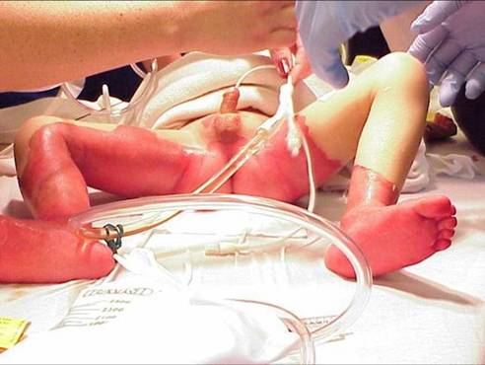
Hot water burns by dipping in
typically symmetrical
severe involvement of the buttocks, perineum, and feet, along with sparing of the knees and nearby areas of the legs.
few or no splash marks,
usually well-demarcated "high-water" mark on the ankles or lower legs.

Slide 4
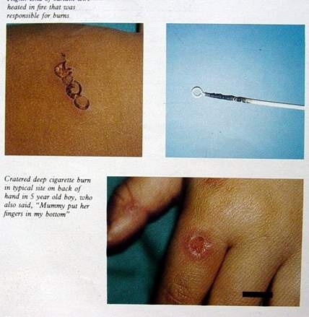
Burns from heated objects

Slide 5
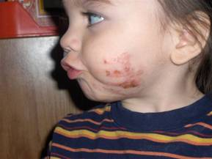
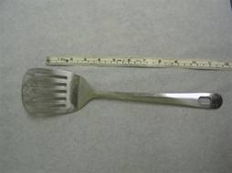
Heated objects

Slide 6
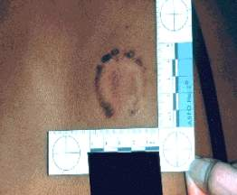
Bite marks
Usually associated with sexual offences
May see anywhere on child’s body
In older children possibility of self biting

Slide 7
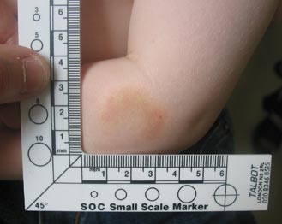
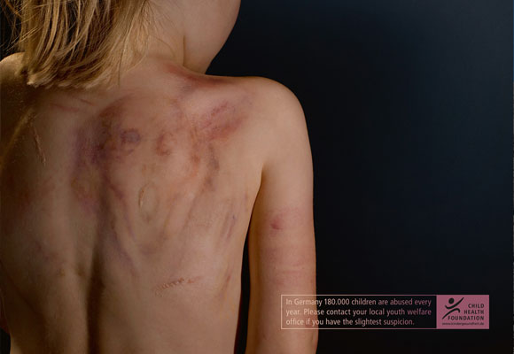
Bite marks

Slide 8
Internal injuries
Almost always confined to the abdomen
Mechanism is direct blows
The duodenum and the proximal jejunum - most common
May see hematoma in wall of bowel or seromuscular tears

Slide 9
Internal injuries cont..
Susceptible because of rich vascular supply and the fixation to the retroperitoneum.
The pancreas, spleen, kidneys, and liver may be injured as a result of direct blows or other blunt trauma.
Physical abuse is a common cause of traumatic pancreatitis in children.

Slide 10
Other injuries
Areas of alopecia with scalp haematomas
Patterned injury
In very young tear in the floor of the mouth
Ligature marks on the penis
Ear injuries

Slide 11
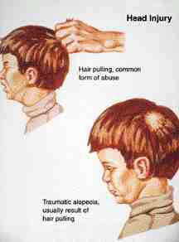
Traumatic alopecia

Slide 12
Child sexual abuse
Refers to any use of children for sexual gratification by adults [4].
4. Bamford F,Roberts R, Child sexual abuse in ABC of Child Abuse 3rd edi pp 38
Characteristic features
The abuser male known to the child
Children of all ages and either sex
Any social class, more commonly in poor families
Type may vary

Slide 13
Ways of presentation
Statements of children
Symptoms due to local trauma / infections
Emotional symptoms
Sexualised conduct/inappropriate knowledge
Pregnancy

Slide 14
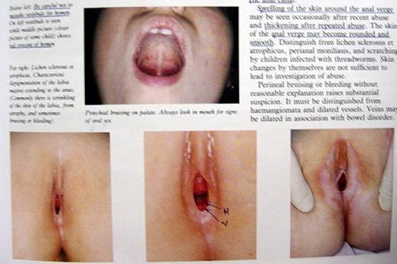
Genital injuries

Slide 15
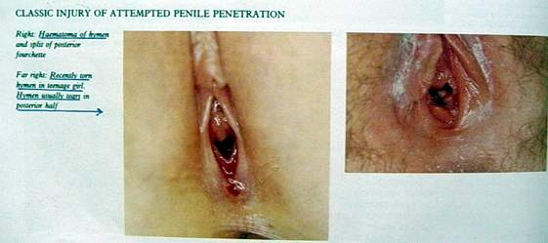
Injuries of penile penitration

Slide 16
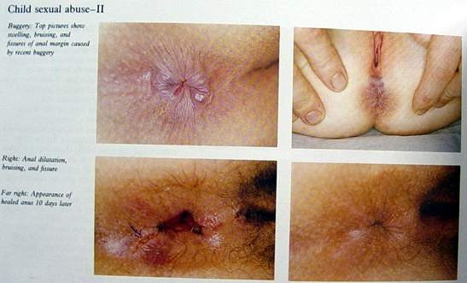
Anal abuse

Slide 17
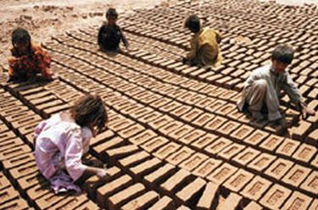

Child labour
If a child less than 14 years is used to earn money it is child labour.

Slide 18
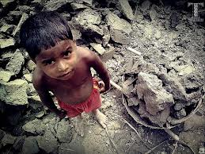
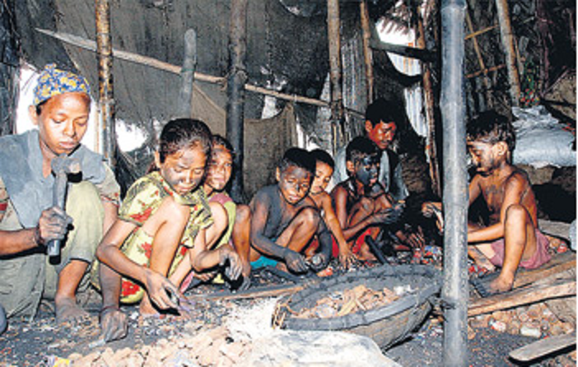
Child labour

Slide 19
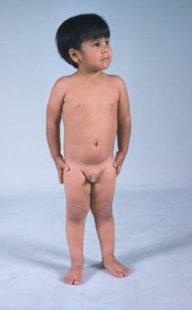
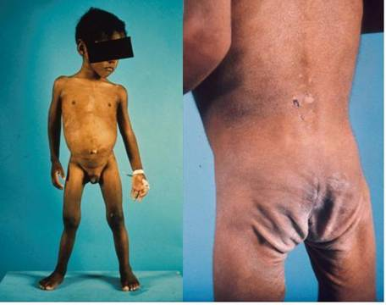
Neglect
Deprivation of care or attention to the child by their parent or guardian is neglect
Same child after proper care and nourishment
Marked decrease in subcutaneous tissue

Slide 20
Munchausen’s syndrome by proxy
Perpetrator fabricates an illness in a child
Repeated visits to doctor
Aetiology is denied by perpetrator
Unnecessary investigations and treatment to child
Symptoms and signs disappear when the child is separated

Slide 21
Common presentations
Bleeding
Seizures
Apnoea
Failure to thrive
Diarrhoea
Vomiting
Fever
Rashes/allergy

Slide 22
Fatal child abuse
Up to 10% risk of death of the child if not intervened
Therefore it is vital to recognize non fatal child abuse.

Slide 23
Causes of death
Blunt force trauma commonly head injury (hitting, beating, shaking, throwing, dropping)
Commonly result in head injury
Secondly rupture of abdominal viscus
Suffocation
Burning
May see classic homicides (shooting, stabbing, strangling)

Slide 24
Investigation of a case of child abuse
History –
Delayed presentation
Inconsistent
Recurrent odd complaints
Video evidence is preferred to prevent the secondary victimization.

Slide 25
Clinical case conference
Initial presentation of the child may be to
Paediatrician
Psychiatrist
JMO
Gynecologist
Once diagnosed possible child abuse
Organize a clinical case conference

Slide 26
What is clinical case conference ?
Sharing of the first hand information by the clinicians to minimize re-victimization
Inform the other specialists about the child
Plan management
Within 24 hours of 1st presenting
Specialist in forensic medicine is responsible in coordination
Decisions documented in BHT
Decide on the institutional case conference

Slide 27
Investigation of a case of child abuse cont..
Visit to the scene
Clothing
Preliminaries-

Slide 28
Investigation of a case of child abuse cont..
External examination
General
Demeanour
Height
Weight
Nourishment
Cleanliness
Specific (injuries and scars)
Review in 7-10 days

Slide 29
Investigation of a case of child abuse cont..
Internal examination (for fatal child abuse)
Special investigations
Radiology
Skeletal survey
CT scan
MRI scan
US scan
Contrast medium radiology
Radio- nucleotide imaging (early detection of skeletal trauma)
Scintigraphy radioisotope bone study

Slide 30
Special investigations cont…
2. Toxicology
3. Haematology (to exclude natural pathology)
4. Histology (eye, chronic SDH, age of injuries in fatal child abuse)

Slide 31
Investigation of a case of child abuse cont..
Referrals
Opinion
Institutional Case conference

Slide 32
Conditions to be excluded
Accidental trauma
Birth trauma
Resuscitation artifacts
Bleeding disorders
Bony diseases
Innocent scars
Dermatological conditions
Self inflicted injuries (Bite marks)

Slide 33
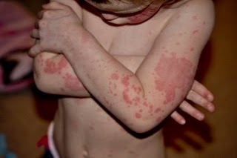
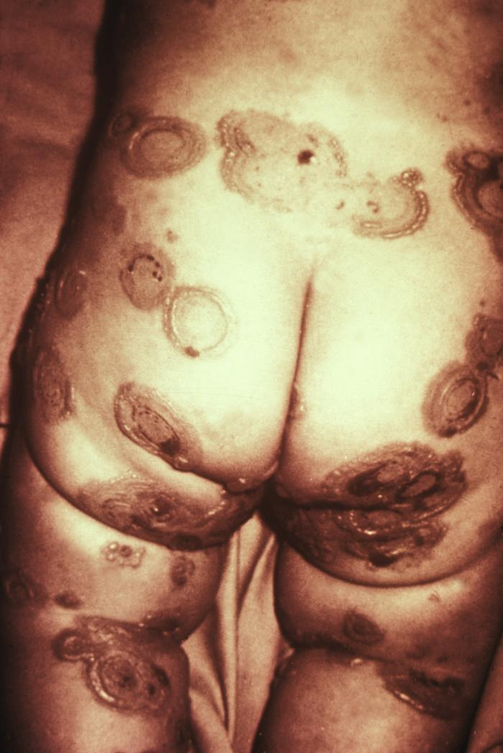
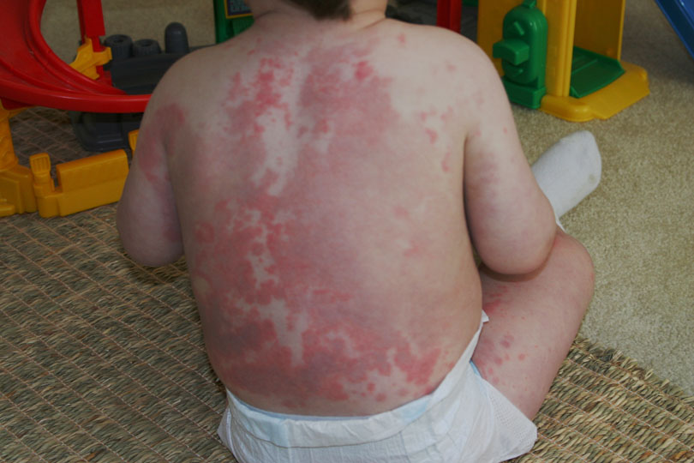
Erythema multiforme

Slide 34
Referrals
Paediatrician
Physician/ surgeon
Obstetrician
Psychiatrist
Eye/ENT surgeon
All X rays to be reported by a consultant radiologist

Slide 35
Management of abused child
Main role is played by the Pediatrician and the psychiatrist
Venerologist, gynecologist, surgeon and other relevant specialists may have a role
JMO’s role in mainly in the referral and sharing information at the Clinical Case Conference (CCC)

Slide 36
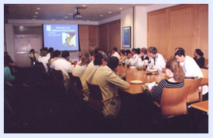
Institiutional Case conference
multidisciplinary forum
sharing of information,
for discussion,
and for making recommendations to social services departments,
which are ultimately responsible for the welfare of the child under discussion.

Slide 37
Aimed at
Diagnosis
Assess the extent
Management (social and psychological)
Decide where the child should go
Monitoring after discharge
Rehabilitation
Counselling of the perpetrator

Slide 38
Participants of the institutional case conference
Probation officer
Police officer from the area
A member from the child protection authority
Paediatrician
JMO
Psychiatrist
Parents or guardian

Slide 39
Difficulties in investigation
History
Child is too little
Under the care of the abuser
Not remember the incident
Child may think that he was abused because he was “naughty”
May not divulge the information to strangers
May not brought at all (tip of the iceberg)
Unawareness of the primary care doctors

Slide 40
Examination - difficulties
Has to take the consent
Delayed presentation
Child may not allow strangers to touch
Conditions mimicking child abuse

Slide 41
Investigations- difficulties
Unavailability
Problems of interpretation (unawareness)
Delayed presentation affects the results

Slide 42
Trial- difficulties
Delay
Child may be suppressed by the court procedures and cross questioning
Embarrassment

Slide 43
Summary
Internal injuries in child abuse except head injury are usually confined to abdomen.
Duodenum, jejunum and pancreas are commonly affected internal organs
Child sexual abuse is common but presentation is less.
Commonest form of fatal child abuse is blunt head injury

Slide 44
Summary cont…
Investigation of a case of child abuse carried out in many steps.
Case conference is an important step in management of victims of child abuse.
There are inherent difficulties associated with investigation of child abuse.

Slide 45

THANK YOU!

